Slide 1

WAY TO ENTERPRISE
Git Tutorial
VTI ACADEMY
Author: duy.nguyenngoc1@vti.com.vn
March 2020

Slide 2
Agenda
Create Github Account
Download Git
Using Git
Copyright © VTI Academy All Rights Reserved

Slide 3
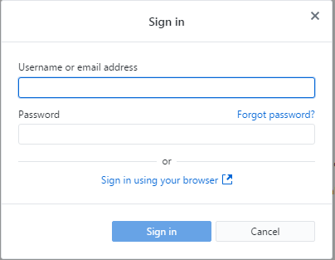
Create Github Account
https://github.com

Slide 4
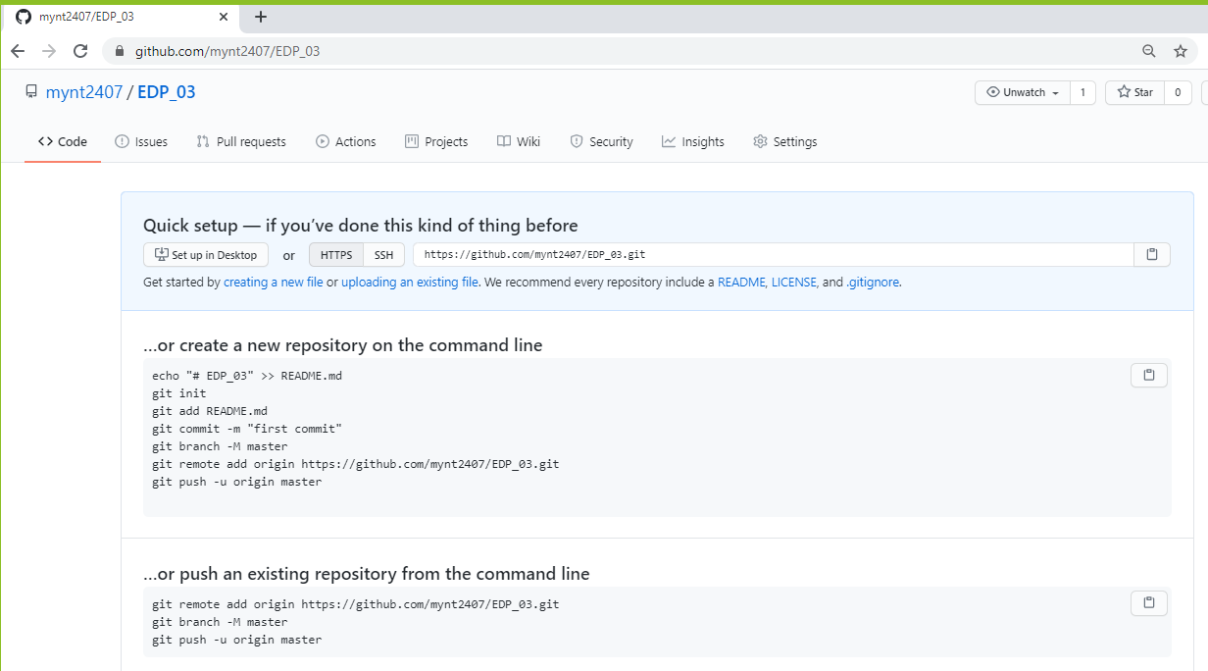
Create Remote Repository

Slide 5
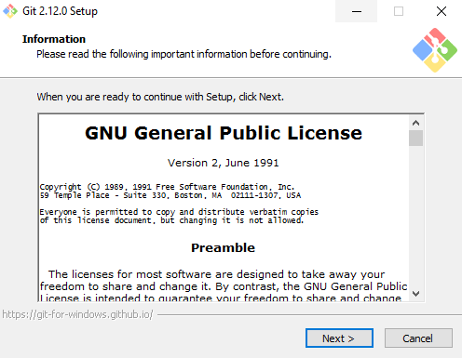
Download Git
https://git-scm.com/download

Slide 6
Using Git
Setting Git User
Clone Repository
Push homework

Slide 7
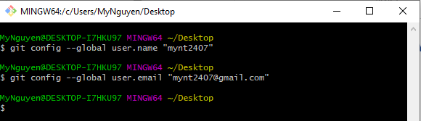
Setting Git User
Notes:
git config --global user.name "Username"
git config --global user.email "Email"

Slide 8
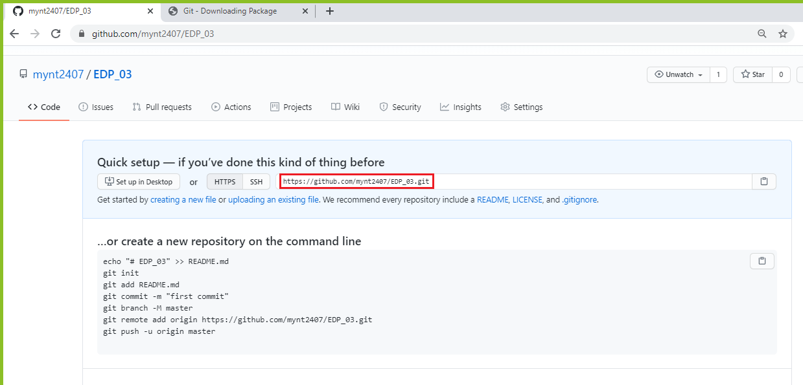
Clone Repository
git clone https://github.com/Username/RepositoryName.git

Slide 9
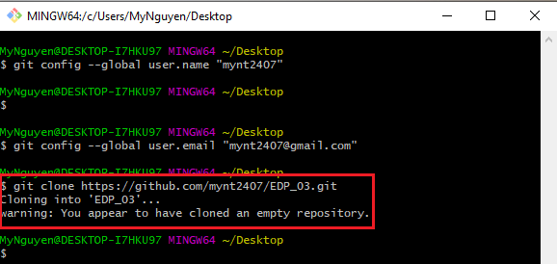
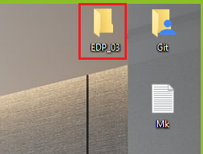
Clone Repository

Slide 10
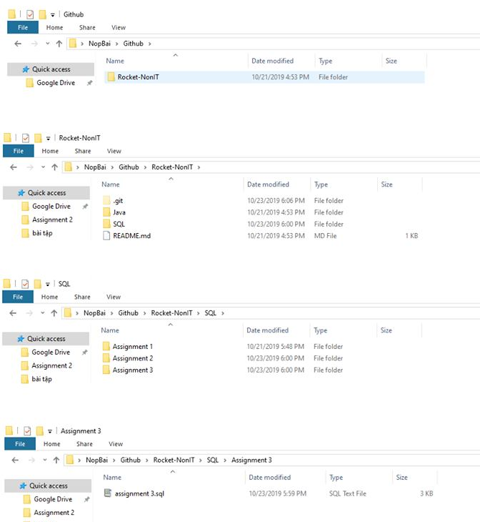
Clone Repository

Slide 11
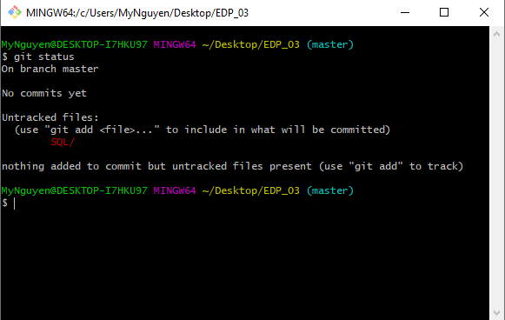
Push homework
git status

Slide 12
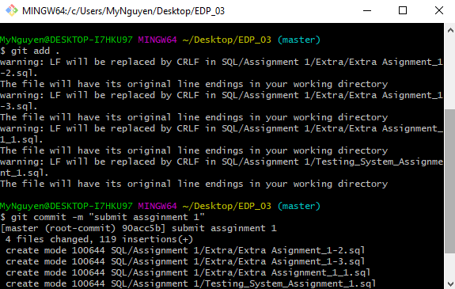
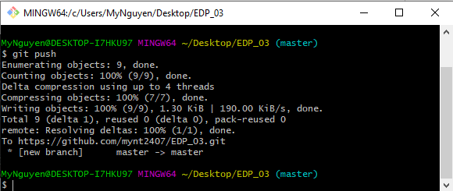
Push homework
git add .
git commit –m “Assignment 1 SQL“
git push

Slide 13
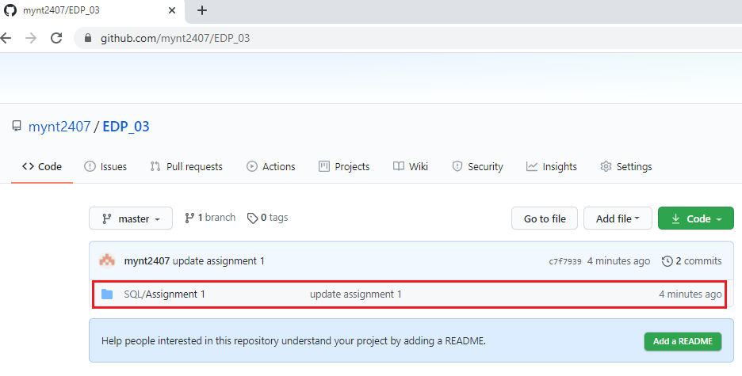
Push homework

Slide 14
Q & A
Copyright © VTI Academy All Rights Reserved

